Slide 1
Electricity

Slide 2
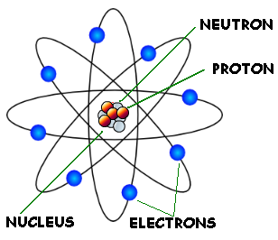
The Basis of Electric Charge
Atoms have three subatomic particles:
The protons are positively charged in the nucleus.
The neutrons are neutral (no charge) in the nucleus.
The electrons are negatively charged surround the nucleus in shells.

Slide 3

Measurement of Charge
If the number of positive (+) and negative (–) charges is equal, the charges cancel each other out and the atom is neutral.
One electron charge is symbolized by $e^{−}$ was given the unit name of coulomb (C).
$$e^{−}=−1.6×{10}^{−19}C$$

Slide 4
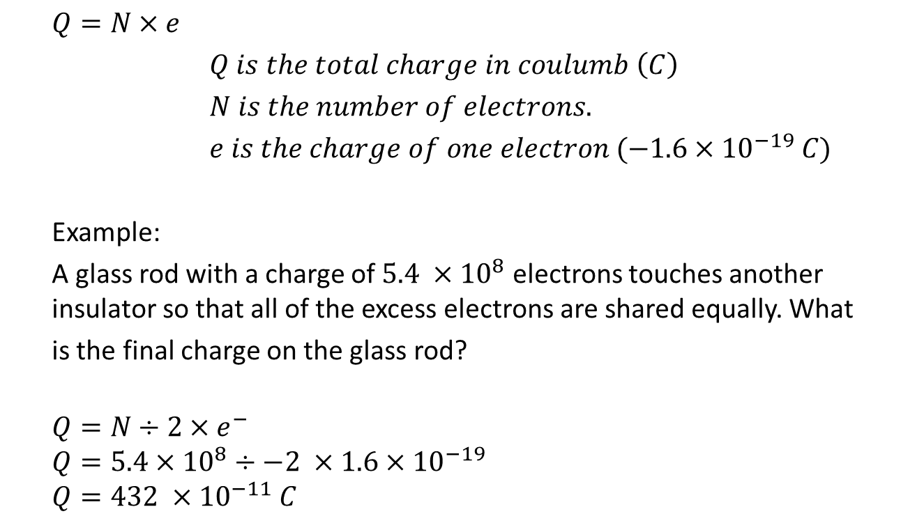
$Q=N×e$
$Q is the total charge in coulumb \left(C\right)$
$N is the number of electrons.$
$e is the charge of one electron (−1.6×{10}^{−19} C)$
Example:
A glass rod with a charge of $5.4 ×{10}^{8}$ electrons touches another insulator so that all of the excess electrons are shared equally. What
is the final charge on the glass rod?
$$Q=N÷2×e^{−}$$
$$Q=5.4×{10}^{8}÷−2 ×1.6×{10}^{−19}$$
$$Q=432 ×{10}^{−11} C$$

Slide 5
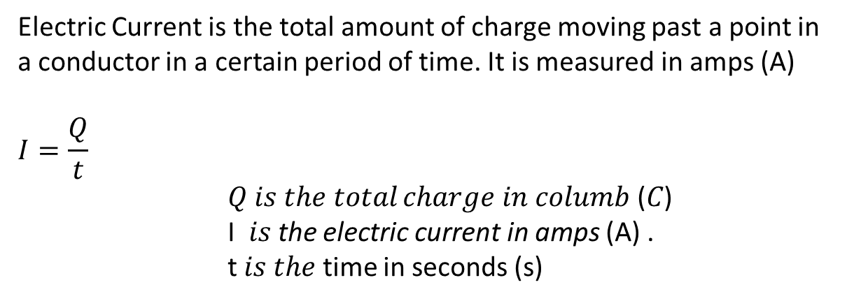
Electric Current (I):
Electric Current is the total amount of charge moving past a point in a conductor in a certain period of time. It is measured in amps (A)
$$I=\frac{Q}{t}$$
𝑄 𝑖𝑠 𝑡ℎ𝑒 𝑡𝑜𝑡𝑎𝑙 𝑐ℎ𝑎𝑟𝑔𝑒 𝑖𝑛 𝑐𝑜𝑙𝑢𝑚𝑏 (𝐶)
I 𝑖𝑠 the electric current in amps (A) .
t 𝑖𝑠 𝑡ℎ𝑒 time in seconds (s)

Slide 6
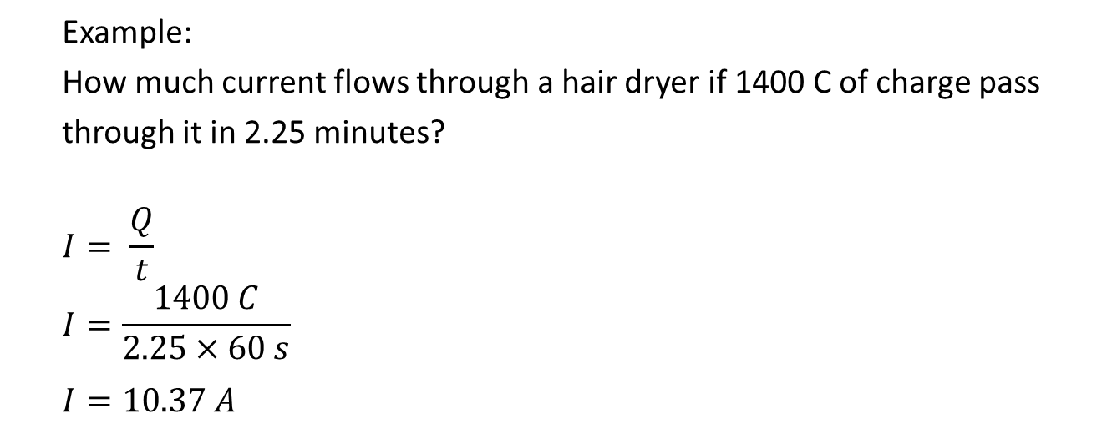
Example:
How much current flows through a hair dryer if 1400 C of charge pass
through it in 2.25 minutes?
$$I= \frac{Q}{t}$$
$$I=\frac{1400 C}{2.25×60 s}$$
$$I=10.37 A$$

Slide 7
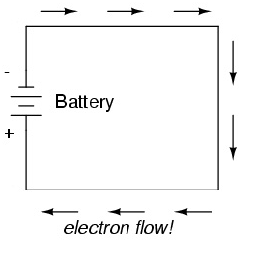
The Direction of Electric Current
The Electric Current (conventional current) moves from the positive (+) terminal through the circuit to the negative (–) terminal of the source.
Actually electrons flow from the negative terminal to the positive terminal of the source.
Current flow

Slide 8
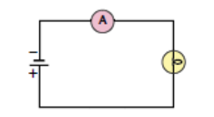
Measurement of Electric Current
An ammeter (a current-measuring device) must be wired so that all current flows through it.
The ammeter must be rewired in series through the circuit.

Slide 9
Electrical Potential
Work had to be done on the bicycle to increase its gravitational potential
Energy to overcome the change in the elevations of the road.
Similarly work is done by the power supply to increase the electrical potential energy of each coulomb to overcome the decrease of energy done by every resistor.
As the charge flows through the circuit (loads), its energy decreases.
Potential Difference
Gravitational and electrical potential energy

Slide 10
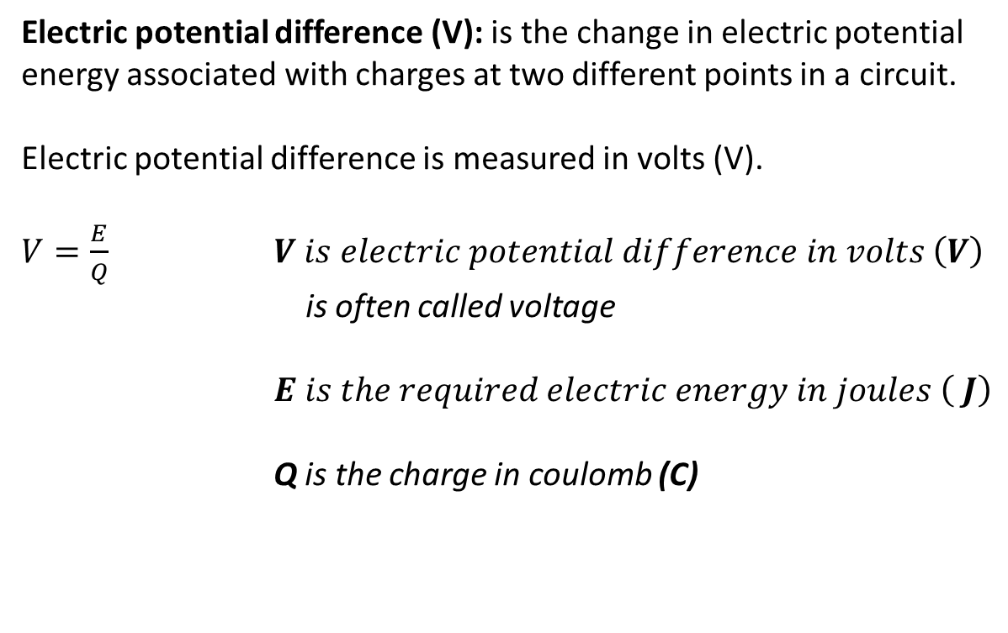
Electrical Potential Difference
Electric potential difference (V): is the change in electric potential energy associated with charges at two different points in a circuit.
Electric potential difference is measured in volts (V).
$V=\frac{E}{Q}$ $V is electric potential difference in volts \left(V\right)$
is often called voltage
$E is the required electric energy in joules \left( J\right)$
Q is the charge in coulomb (C)

Slide 11
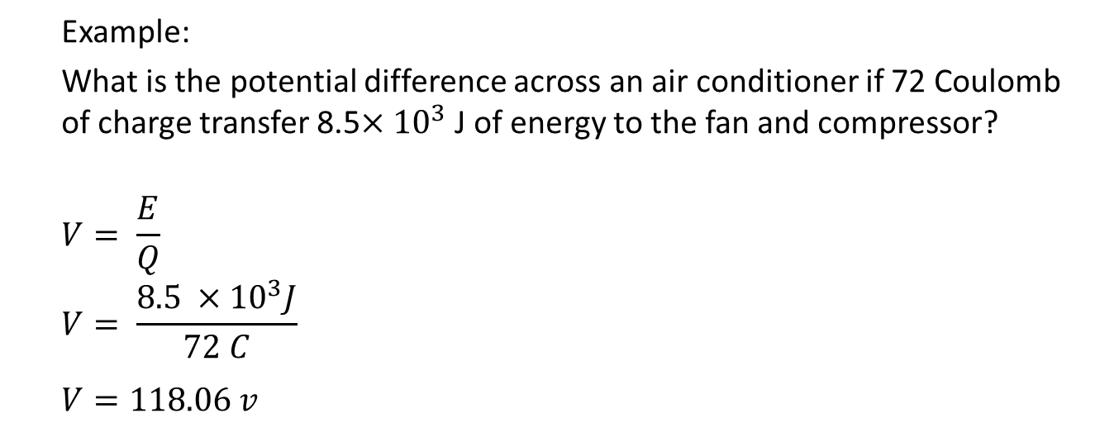
Example:
What is the potential difference across an air conditioner if 72 Coulomb of charge transfer 8.5$×{10}^{3}$J of energy to the fan and compressor?
$$V= \frac{E}{Q}$$
$$V= \frac{8.5 ×{10}^{3}J}{72 C}$$
$$V=118.06 v$$
H. W. questions # 1 – 9 on page 513 of the textbook

Slide 12
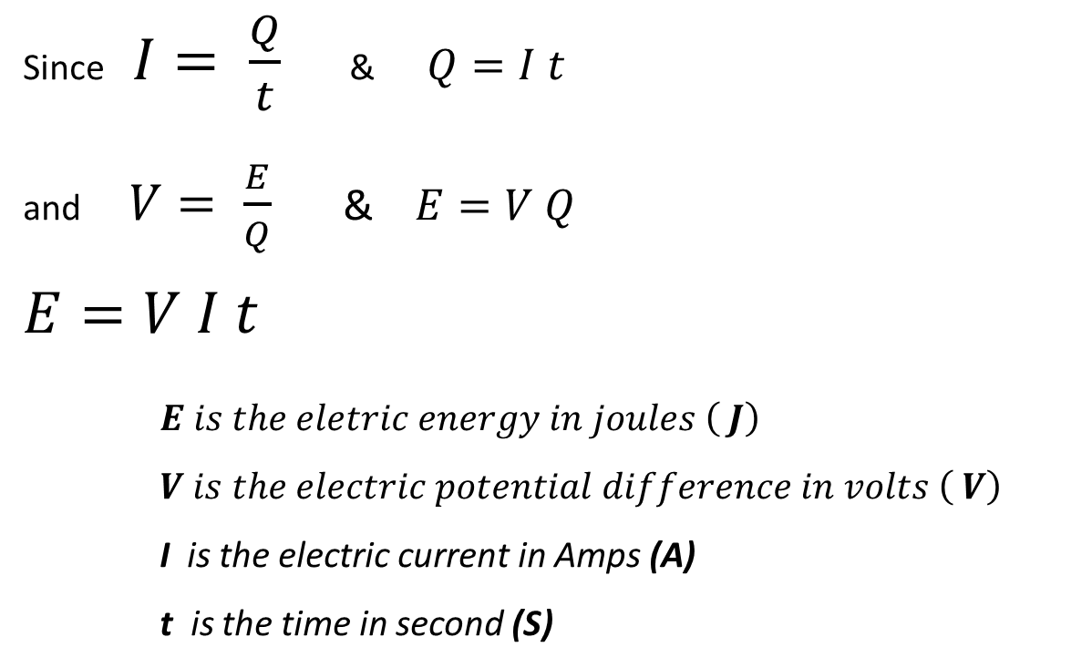
Electrical Energy
Since$I= \frac{Q}{t}$ & $Q=I t$
and$V= \frac{E}{Q}$ & $E=V Q$
$$E=V I t$$
$E is the eletric energy in joules \left( J\right)$
$V is the electric potential difference in volts \left( V\right)$
I is the electric current in Amps (A)
t is the time in second (S)

Slide 13
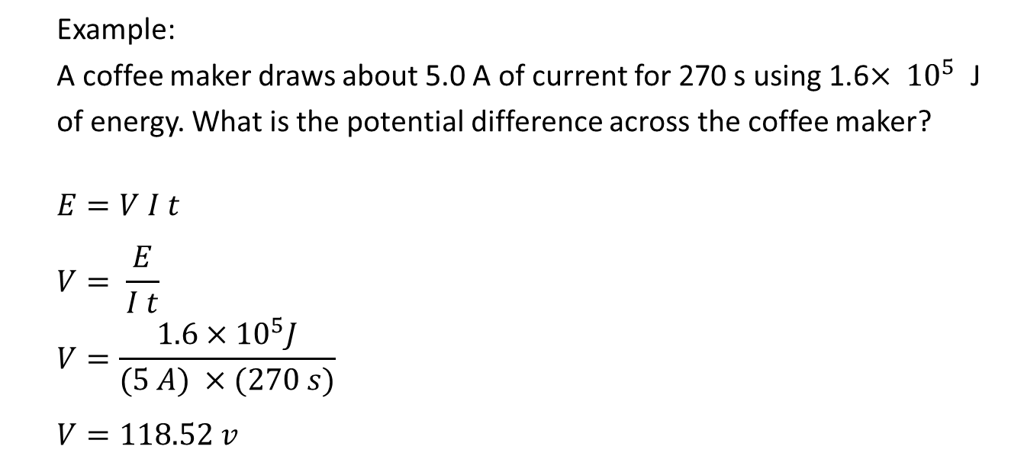
Example:
A coffee maker draws about 5.0 A of current for 270 s using 1.6$× {10}^{5}$ J
of energy. What is the potential difference across the coffee maker?
$$E=V I t$$
$$V= \frac{E}{I t}$$
$$V=\frac{1.6×{10}^{5}J}{(5 A) ×(270 s)}$$
$$V=118.52 v$$

Slide 14
Drawing Circuits

Slide 15
Drawing Circuits

Slide 16
Measuring Potential Difference
A voltmeter (a potential difference measuring device) must be connected in parallel with a load in the circuit.
It used to compare the potential difference before and after the load.

Slide 17
Resistance
The amount of current flow in a circuit, depends on the potential difference of the power supply and the nature of the pathway through the loads that are using the electric potential energy.
The more difficult the path, the more opposition to the flow. The measure of this opposition to flow is called electrical resistance.
What is Electric Resistance

Slide 18
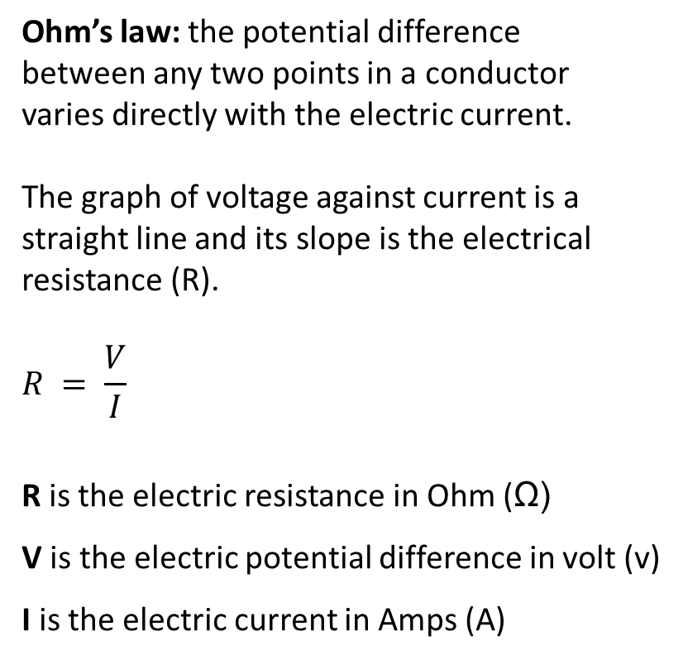
Ohm’s Law
Ohm’s law: the potential difference
between any two points in a conductor
varies directly with the electric current.
The graph of voltage against current is a straight line and its slope is the electrical resistance (R).
$$R = \frac{V}{I}$$
R is the electric resistance in Ohm (Ω)
V is the electric potential difference in volt (v)
I is the electric current in Amps (A)

Slide 19
Resistors
Resistors are electrical devices that have a specific resistance.
There are many different types of resistors. For example; Dimmer switches and the volume controls on a stereo are examples of variable resistors – resistors that allow you can
change their resistance.

Slide 20
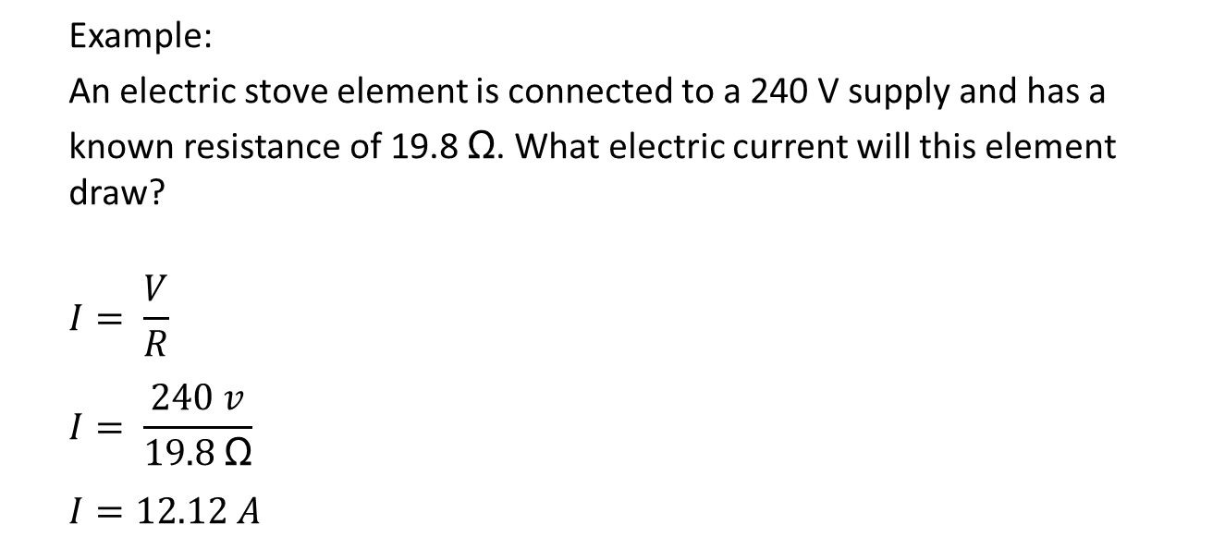
Example:
An electric stove element is connected to a 240 V supply and has a
known resistance of 19.8 Ω. What electric current will this element draw?
$$I= \frac{V}{R}$$
$$I= \frac{240 v}{19.8 \text{Ω}}$$
$$I=12.12 A$$

Slide 21
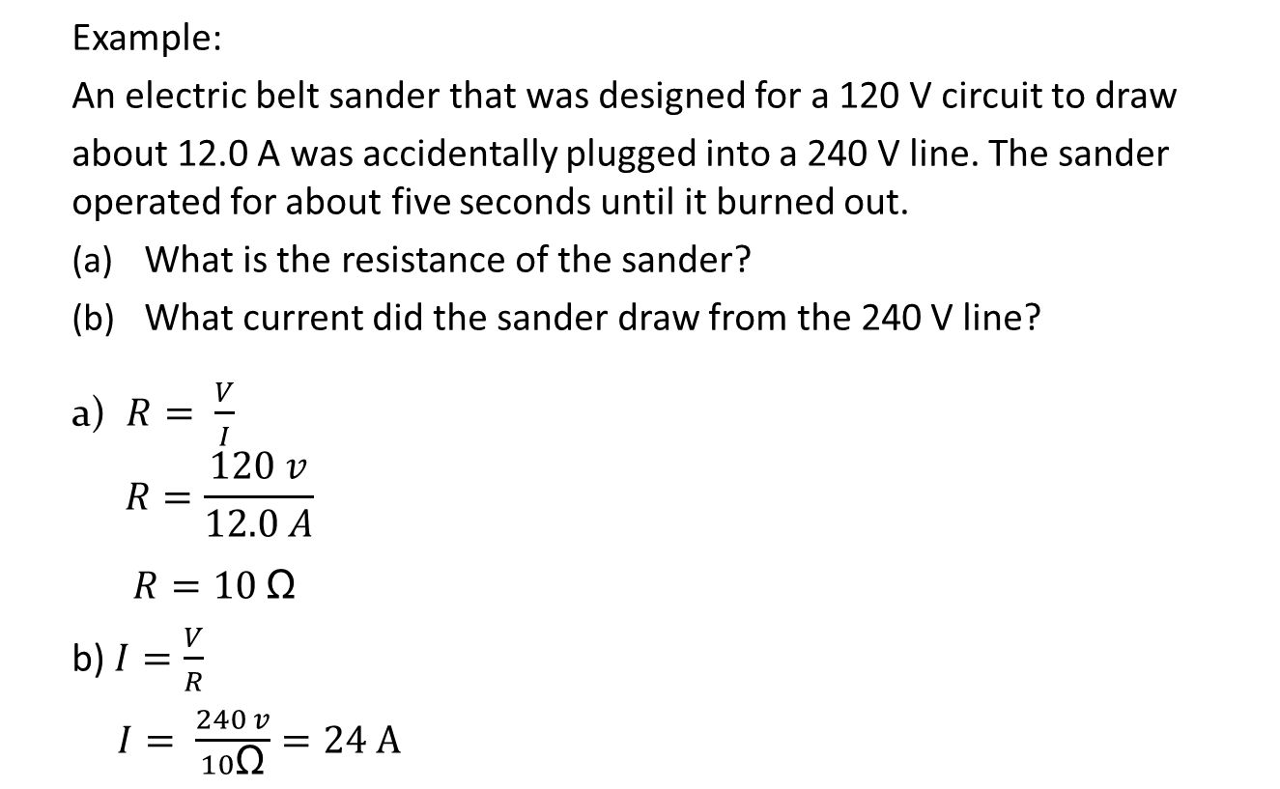
Example:
An electric belt sander that was designed for a 120 V circuit to draw
about 12.0 A was accidentally plugged into a 240 V line. The sander operated for about five seconds until it burned out.
What is the resistance of the sander?
What current did the sander draw from the 240 V line?
a) $R= \frac{V}{I}$
$$R=\frac{120 v}{12.0 A}$$
$R=10 \text{Ω}$
b) $I=\frac{V}{R}$
$I= \frac{240 v}{10\text{Ω}}=24 A$
Questions # 1 – 7 on page 513 and Questions # 1 – 9 on page 518 of the text book

Slide 22
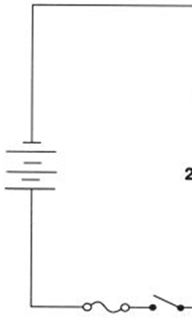
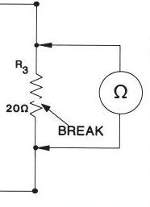

Measuring resistance
An ohmmeter is a device used to measure electrical resistance.
The symbol for an ohmmeter is
Ohmmeters are connected in parallel and must never be used on a circuit if the circuit is live.
R

Slide 23
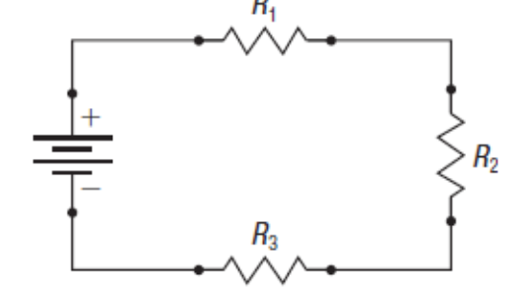
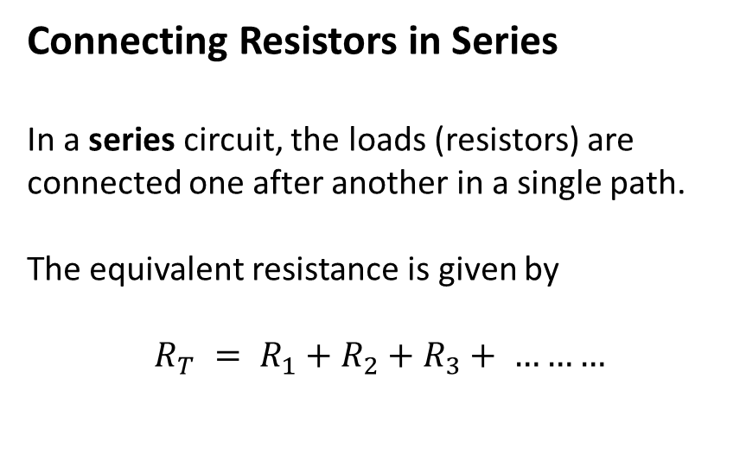

Kirchhoff’s Voltage Law
Connecting Resistors in Series
In a series circuit, the loads (resistors) are connected one after another in a single path.
The equivalent resistance is given by
$$R_{T} = R_{1}+R_{2}+R_{3}+ ………$$
$$R_{T}$$

Slide 24
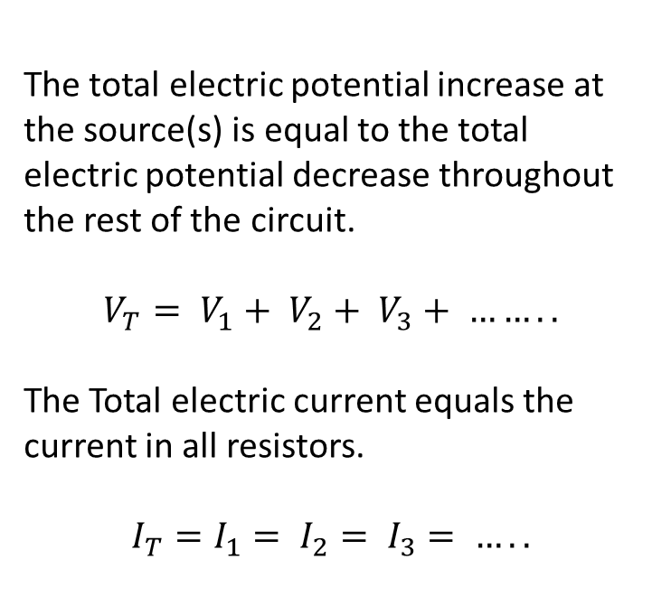
Kirchhoff’s Voltage Law
The total electric potential increase at the source(s) is equal to the total electric potential decrease throughout the rest of the circuit.
$$V_{T}= V_{1}+ V_{2}+ V_{3}+ ……..$$
The Total electric current equals the current in all resistors.
$$I_{T}=I_{1}= I_{2}= I_{3}= …..$$

Slide 25
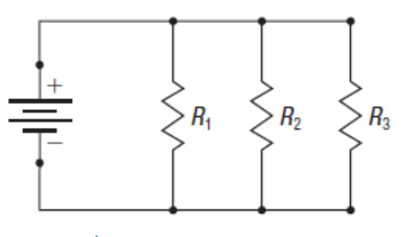
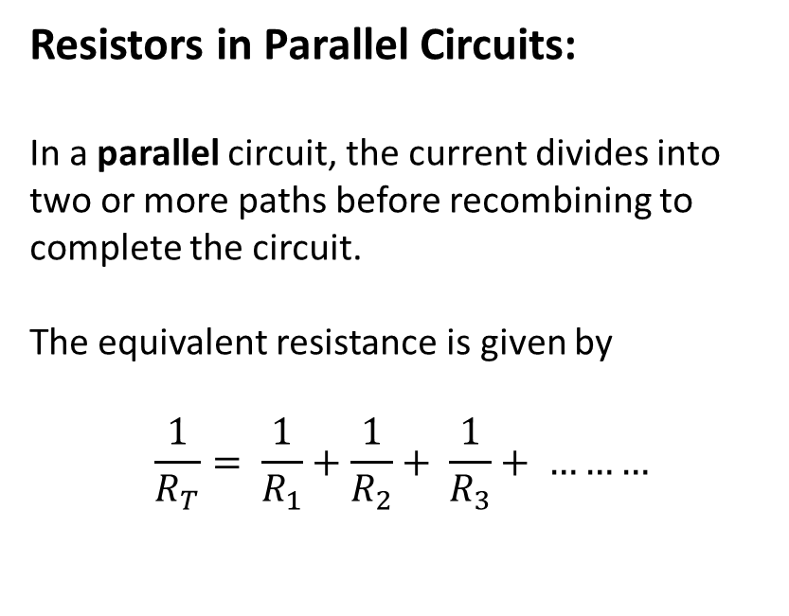

Kirchhoff’s Voltage Law
Resistors in Parallel Circuits:
In a parallel circuit, the current divides into two or more paths before recombining to complete the circuit.
The equivalent resistance is given by
$$\frac{1}{R_{T}}= \frac{1}{R_{1}}+\frac{1}{R_{2}}+ \frac{1}{R_{3}}+ ………$$
$$R_{T}$$

Slide 26

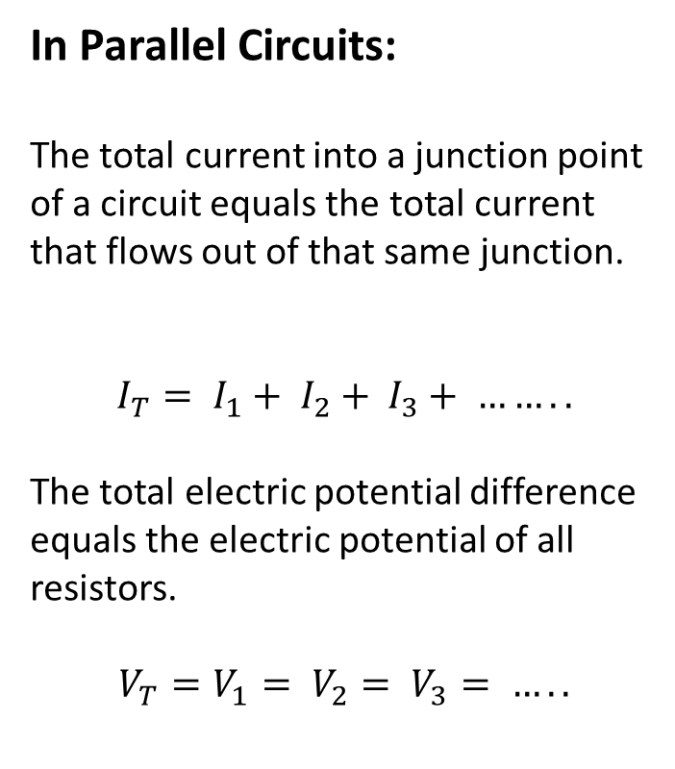



Kirchhoff’s Current Law
In Parallel Circuits:
The total current into a junction point of a circuit equals the total current that flows out of that same junction.
$$I_{T}= I_{1}+ I_{2}+ I_{3}+ ……..$$
The total electric potential difference equals the electric potential of all resistors.
$$V_{T}=V_{1}= V_{2}= V_{3}= …..$$
$$I_{1}$$
$$I_{2}$$
$$I_{3}$$
$$I_{T}$$

Slide 27
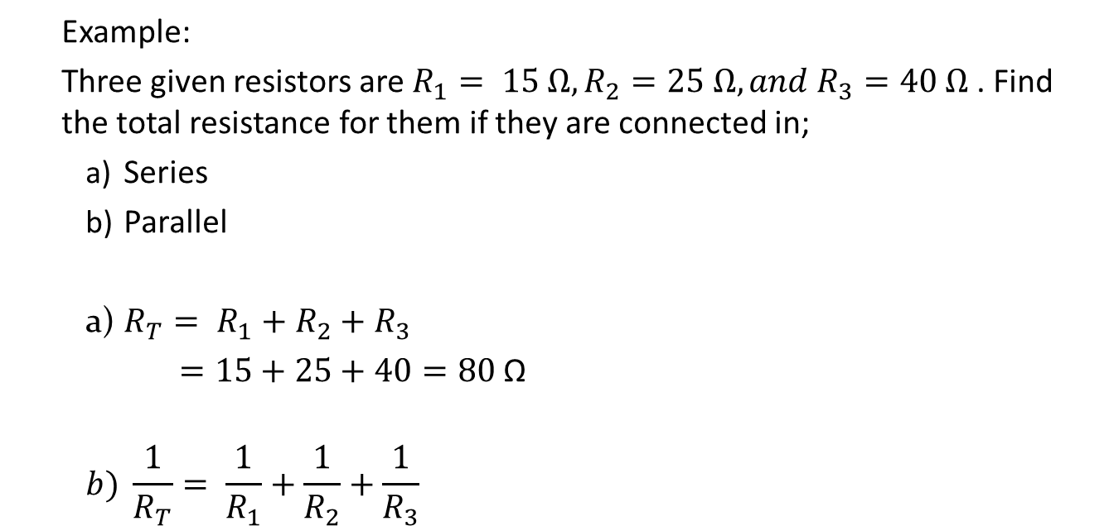
Example:
Three given resistors are $R_{1}= 15 Ω,R_{2}=25 Ω, and{ R}_{3}=40 Ω$. Find the total resistance for them if they are connected in;
Series
Parallel
a) $R_{T}= R_{1}+R_{2}+R_{3}$
$=15+25+40=80$ Ω
$$b) \frac{1}{R_{T}}= \frac{1}{R_{1}}+\frac{1}{R_{2}}+\frac{1}{R_{3}}$$
H W questions 1 – 2 on page 522 and # 1 – 12 on page 526 of the textbook

Slide 28
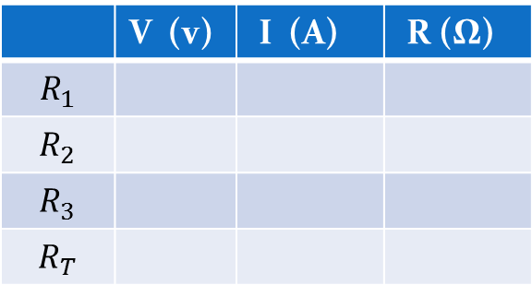
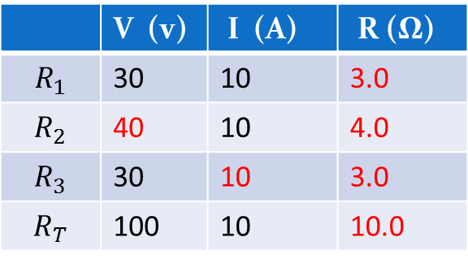
Example:
The given figure shows a simple series circuit. Use Kirchhoff’s voltage and current laws to complete the given chart.
 | V (v) | I (A) | R (Ω)
$$R_{1}$$ | 30 | 10 | 3.0
$$R_{2}$$ | 40 | 10 | 4.0
$$R_{3}$$ | 30 | 10 | 3.0
$$R_{T}$$ | 100 | 10 | 10.0
 | V (v) | I (A) | R (Ω)
$$R_{1}$$
$$R_{2}$$
$$R_{3}$$
$$R_{T}$$

Slide 29
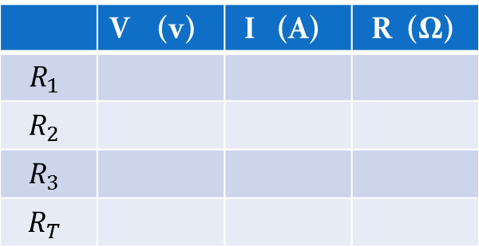
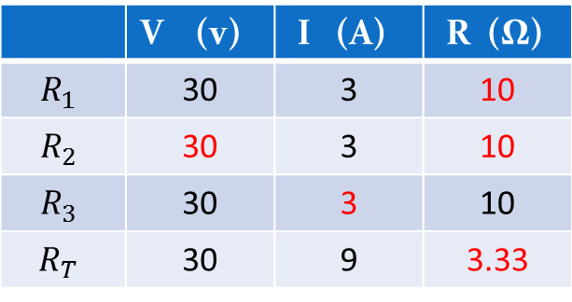
Example:
The given figure shows a simple parallel circuit. Use Kirchhoff’s voltage and current laws to complete the given chart.
 | V (v) | I (A) | R (Ω)
$$R_{1}$$ | 30 | 3 | 10
$$R_{2}$$ | 30 | 3 | 10
$$R_{3}$$ | 30 | 3 | 10
$$R_{T}$$ | 30 | 9 | 3.33
 | V (v) | I (A) | R (Ω)
$$R_{1}$$
$$R_{2}$$
$$R_{3}$$
$$R_{T}$$

Slide 30
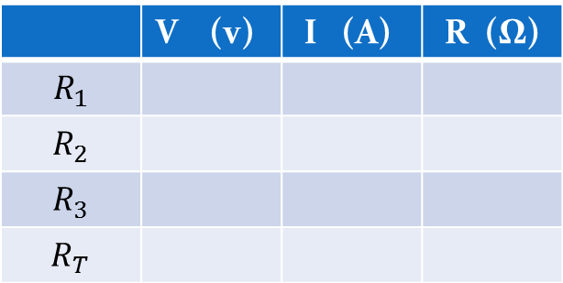
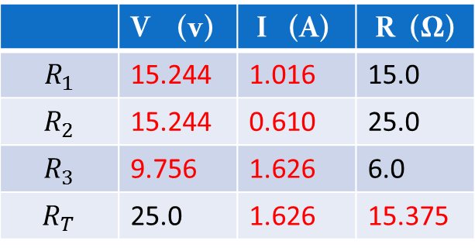
Circuit Analysis
For the circuit shown in the given diagram, the potential difference of the power supply is 25.0 V.
Find all the missing parameters in the circuit.
 | V (v) | I (A) | R (Ω)
$$R_{1}$$ | 15.244 | 1.016 | 15.0
$$R_{2}$$ | 15.244 | 0.610 | 25.0
$$R_{3}$$ | 9.756 | 1.626 | 6.0
$$R_{T}$$ | 25.0 | 1.626 | 15.375
 | V (v) | I (A) | R (Ω)
$$R_{1}$$
$$R_{2}$$
$$R_{3}$$
$$R_{T}$$

Slide 31
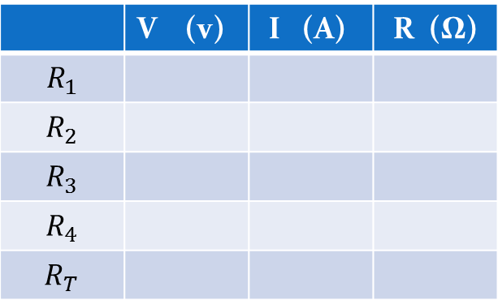
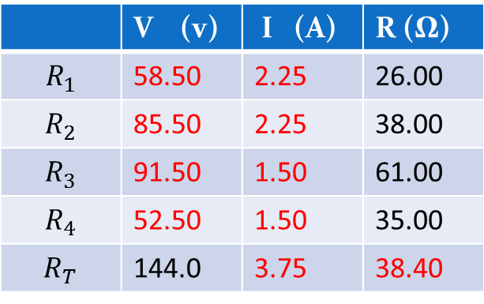
Example:
For the circuit in the given diagram, the potential difference of the power supply is 144 V.
Find all the missing parameters in the circuit.
 | V (v) | I (A) | R (Ω)
$$R_{1}$$ | 58.50 | 2.25 | 26.00
$$R_{2}$$ | 85.50 | 2.25 | 38.00
$$R_{3}$$ | 91.50 | 1.50 | 61.00
$$R_{4}$$ | 52.50 | 1.50 | 35.00
$$R_{T}$$ | 144.0 | 3.75 | 38.40
 | V (v) | I (A) | R (Ω)
$$R_{1}$$
$$R_{2}$$
$$R_{3}$$
$$R_{4}$$
$$R_{T}$$

Slide 32
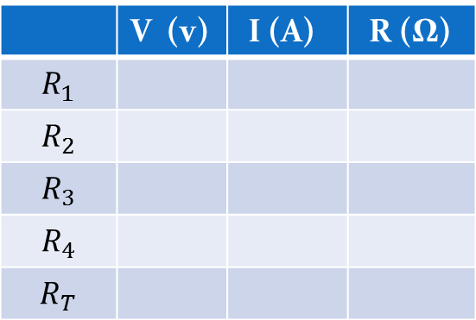
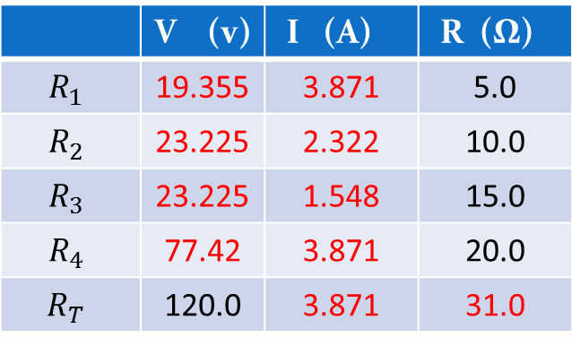
Example:
The game board consists of a circuit in the given Figure has numerous unknown parameters.
Find all the missing parameters in the circuit.
 | V (v) | I (A) | R (Ω)
$$R_{1}$$ | 19.355 | 3.871 | 5.0
$$R_{2}$$ | 23.225 | 2.322 | 10.0
$$R_{3}$$ | 23.225 | 1.548 | 15.0
$$R_{4}$$ | 77.42 | 3.871 | 20.0
$$R_{T}$$ | 120.0 | 3.871 | 31.0
 | V (v) | I (A) | R (Ω)
$$R_{1}$$
$$R_{2}$$
$$R_{3}$$
$$R_{4}$$
$$R_{T}$$

Slide 33
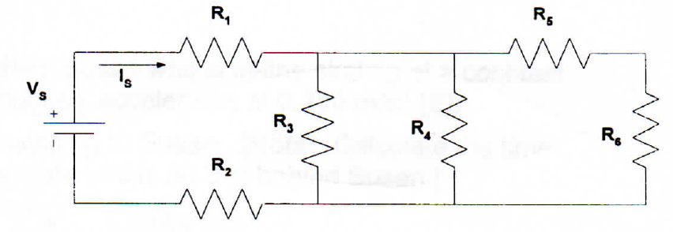
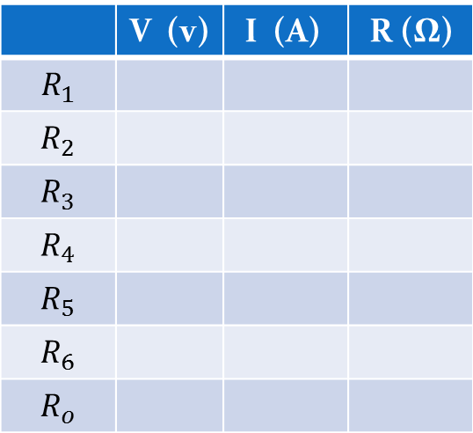
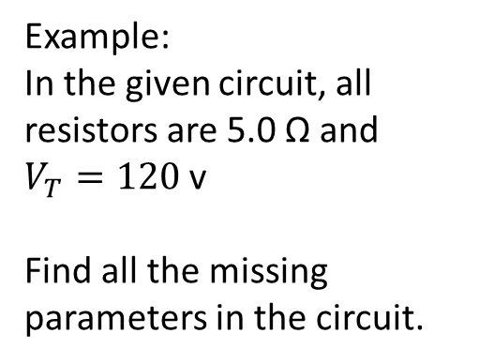
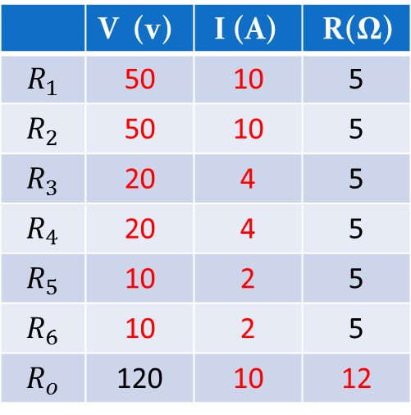
Example:
In the given circuit, all resistors are 5.0 Ω and $V_{T}=120$ v
Find all the missing parameters in the circuit.
 | V (v) | I (A) | R(Ω)
$$R_{1}$$ | 50 | 10 | 5
$$R_{2}$$ | 50 | 10 | 5
$$R_{3}$$ | 20 | 4 | 5
$$R_{4}$$ | 20 | 4 | 5
$$R_{5}$$ | 10 | 2 | 5
$$R_{6}$$ | 10 | 2 | 5
$$R_{o}$$ | 120 | 10 | 12
 | V (v) | I (A) | R (Ω)
$$R_{1}$$
$$R_{2}$$
$$R_{3}$$
$$R_{4}$$
$$R_{5}$$
$$R_{6}$$
$$R_{o}$$

Slide 34
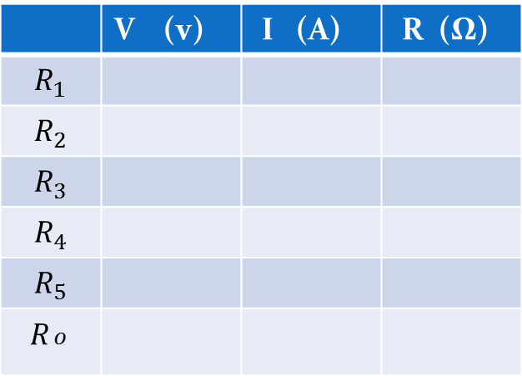
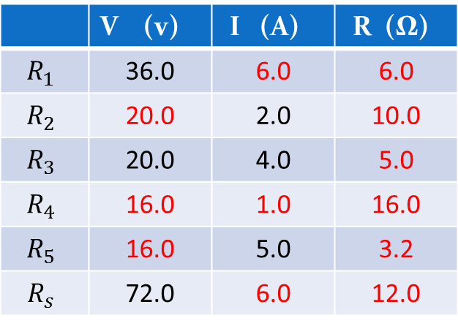
Example:
In the circuit in given figure, find the unknown values in the electric circuit given.
 | V (v) | I (A) | R (Ω)
$$R_{1}$$ | 36.0 | 6.0 | 6.0
$$R_{2}$$ | 20.0 | 2.0 | 10.0
$$R_{3}$$ | 20.0 | 4.0 | 5.0
$$R_{4}$$ | 16.0 | 1.0 | 16.0
$$R_{5}$$ | 16.0 | 5.0 | 3.2
$$R_{s}$$ | 72.0 | 6.0 | 12.0
 | V (v) | I (A) | R (Ω)
$$R_{1}$$
$$R_{2}$$
$$R_{3}$$
$$R_{4}$$
$$R_{5}$$
$$R_{\begin{aligned}o \\ \end{aligned}}$$

Slide 35
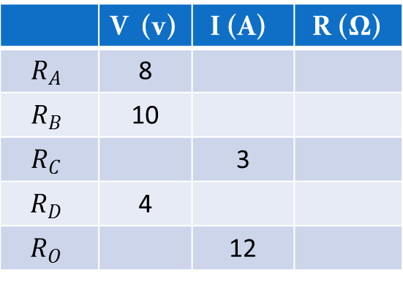
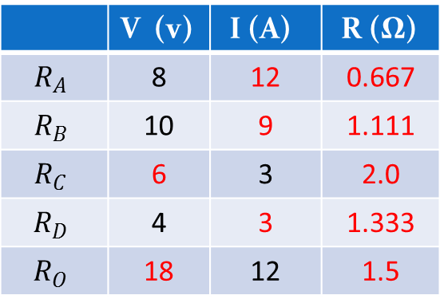
Example:
In the circuit in given figure, find the unknown values in the electric circuit given.
 | V (v) | I (A) | R (Ω)
$$R_{A}$$ | 8 | 12 | 0.667
$$R_{B}$$ | 10 | 9 | 1.111
$$R_{C}$$ | 6 | 3 | 2.0
$$R_{D}$$ | 4 | 3 | 1.333
$$R_{O}$$ | 18 | 12 | 1.5
 | V (v) | I (A) | R (Ω)
$$R_{A}$$ | 8
$$R_{B}$$ | 10
$$R_{C}$$ |  | 3
$$R_{D}$$ | 4
$$R_{O}$$ |  | 12

Slide 36
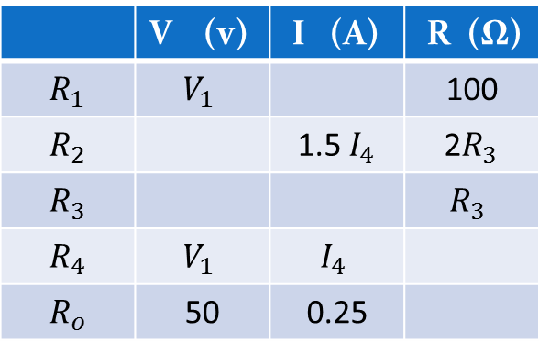
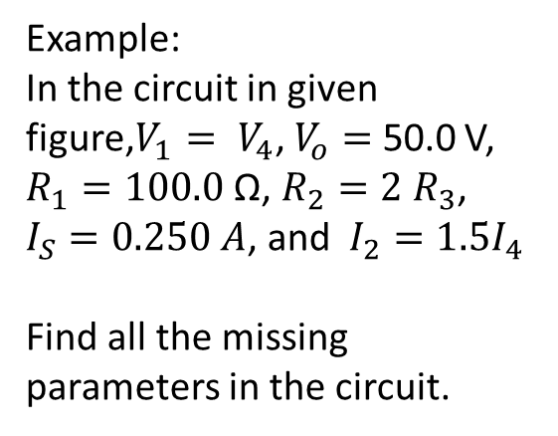
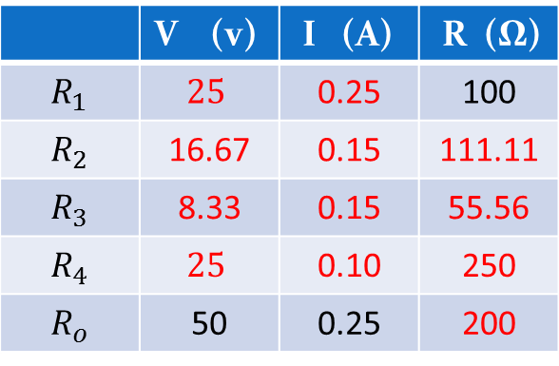
Example:
In the circuit in given figure,$V_{1}= V_{4}$, $V_{o}=$ 50.0 V,
$R_{1}=100.0$ Ω, $R_{2}=2 R_{3}$, $I_{S}=0.250 A$, and $I_{2}=1.5I_{4}$
Find all the missing parameters in the circuit.
 | V (v) | I (A) | R (Ω)
$$R_{1}$$ | $$25$$ | 0.25 | 100
$$R_{2}$$ | 16.67 | 0.15 | 111.11
$$R_{3}$$ | 8.33 | 0.15 | 55.56
$$R_{4}$$ | $$25$$ | 0.10 | 250
$$R_{o}$$ | 50 | 0.25 | 200
 | V (v) | I (A) | R (Ω)
$$R_{1}$$ | $$V_{1}$$ |  | 100
$$R_{2}$$ |  | 1.5 $I_{4}$ | 2$R_{3}$
$$R_{3}$$ |  |  | $$R_{3}$$
$$R_{4}$$ | $$V_{1}$$ | $$I_{4}$$
$$R_{o}$$ | 50 | 0.25

Slide 37
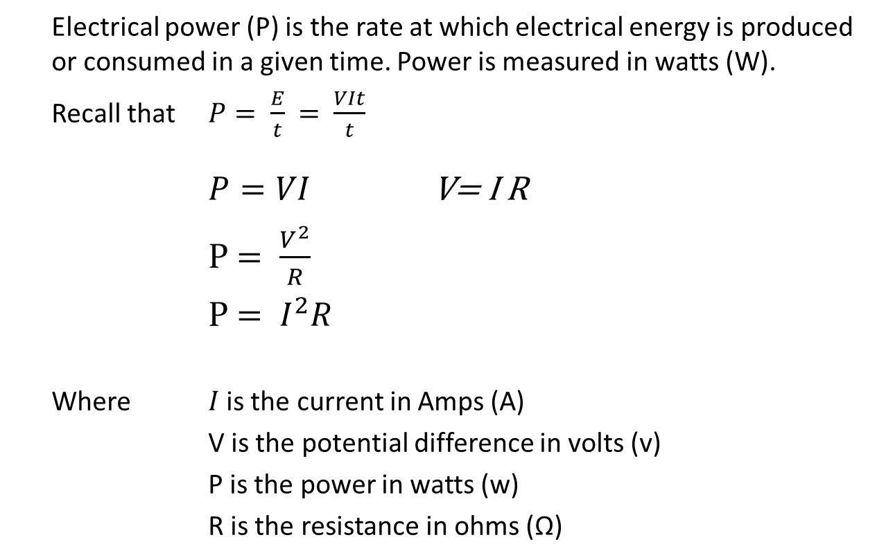
Power in Electric Circuits
Electrical power (P) is the rate at which electrical energy is produced or consumed in a given time. Power is measured in watts (W).
Recall that $P= \frac{E}{t}$ $= \frac{VIt}{t}$
$P=VI$ V= I R
P $= \frac{V^{2}}{R}$
P $= I^{2}R$
Where $I$is the current in Amps (A)
V is the potential difference in volts (v)
P is the power in watts (w)
R is the resistance in ohms (Ω)

Slide 38
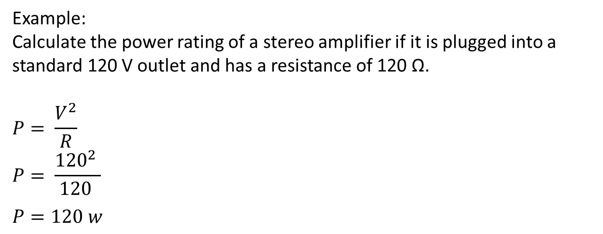
Example:
Calculate the power rating of a stereo amplifier if it is plugged into a standard 120 V outlet and has a resistance of 120 Ω.
$$P= \frac{V^{2}}{R}$$
$$P= \frac{{120}^{2} }{120 }$$
$$P=120 w$$

Slide 39
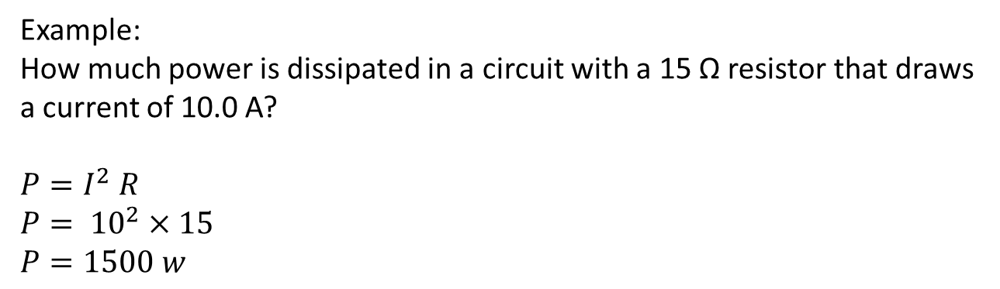
Example:
How much power is dissipated in a circuit with a 15 Ω resistor that draws a current of 10.0 A?
$$P=I^{2} R$$
$$P= {10}^{2}×15$$
$$P=1500 w$$

Slide 40
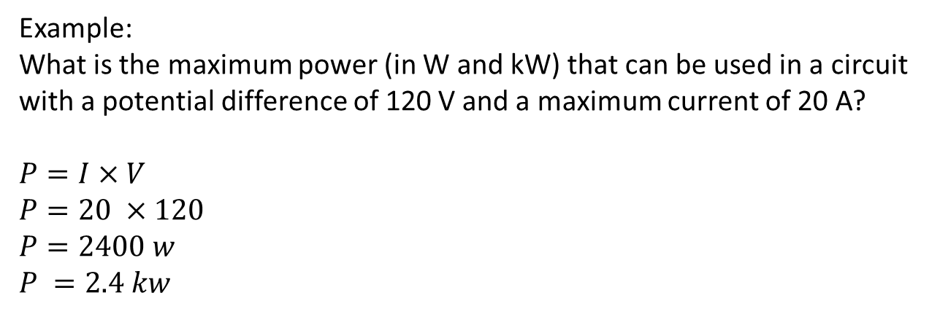
Example:
What is the maximum power (in W and kW) that can be used in a circuit with a potential difference of 120 V and a maximum current of 20 A?
$$P=I×V$$
$$P=20 ×120$$
$$P=2400 w$$
$$P =2.4 kw$$

Slide 41
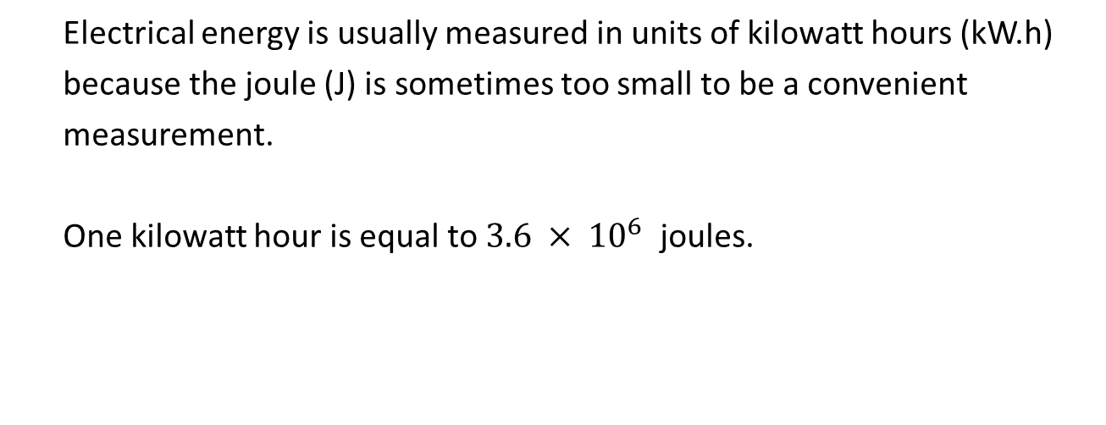
Electric Energy
Electrical energy is usually measured in units of kilowatt hours (kW.h)
because the joule (J) is sometimes too small to be a convenient
measurement.
One kilowatt hour is equal to $3.6 × {10}^{6}$ joules.

Slide 42
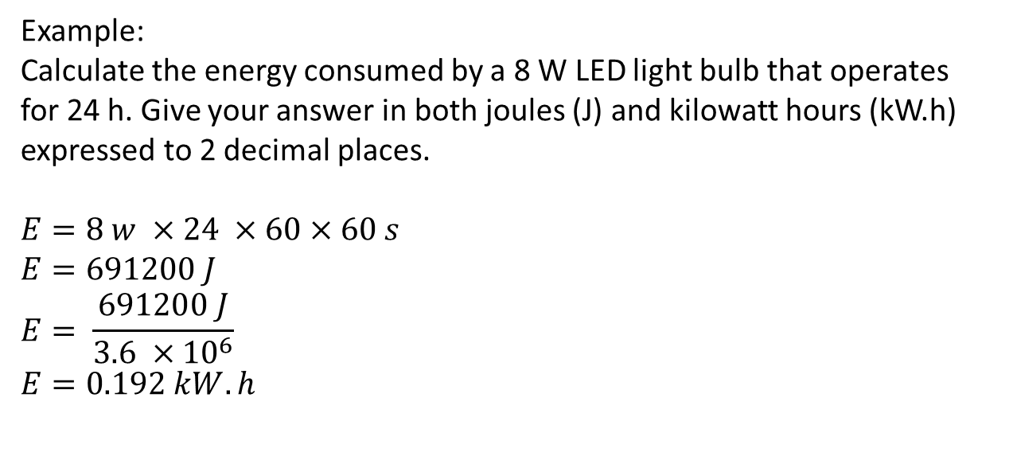
Example:
Calculate the energy consumed by a 8 W LED light bulb that operates
for 24 h. Give your answer in both joules (J) and kilowatt hours (kW.h)
expressed to 2 decimal places.
$$E=8 w ×24 ×60×60 s$$
$$E=691200 J$$
$$E= \frac{691200 J}{3.6 ×{10}^{6}}$$
$$E=0.192 kW.h$$
H. W. Questions # 9, 11, 12, 13, 15, 16, 17, 19, 20, 21, 23, 25, 26, 27, 31, 32, 33, 34, 35, 36, 37 on pages 575 – 578 of the package

